Slide 1
Implementing microservices on AWS using Amazon API Gateway, Lambda and DynamoDB
Presented by: Chinwuba Chidubem

Slide 2
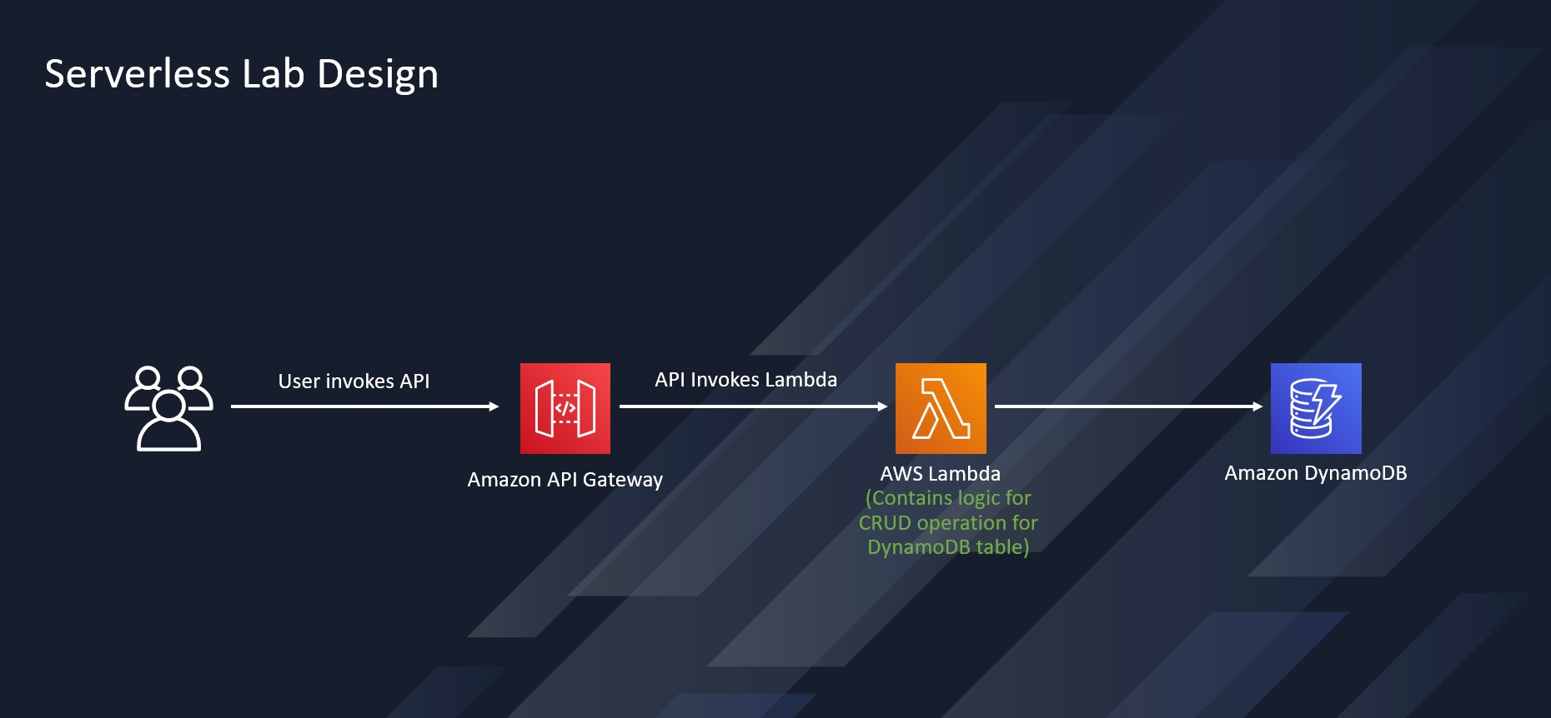
ARCHITECTURE

Slide 3
OUTLINE
Create Lambda IAM Role
Create Lambda Function
Create DynamoDB Table
Create API Using API Gateway
Deploy the API Using Postman
Update the DynamoDB Table

Slide 4
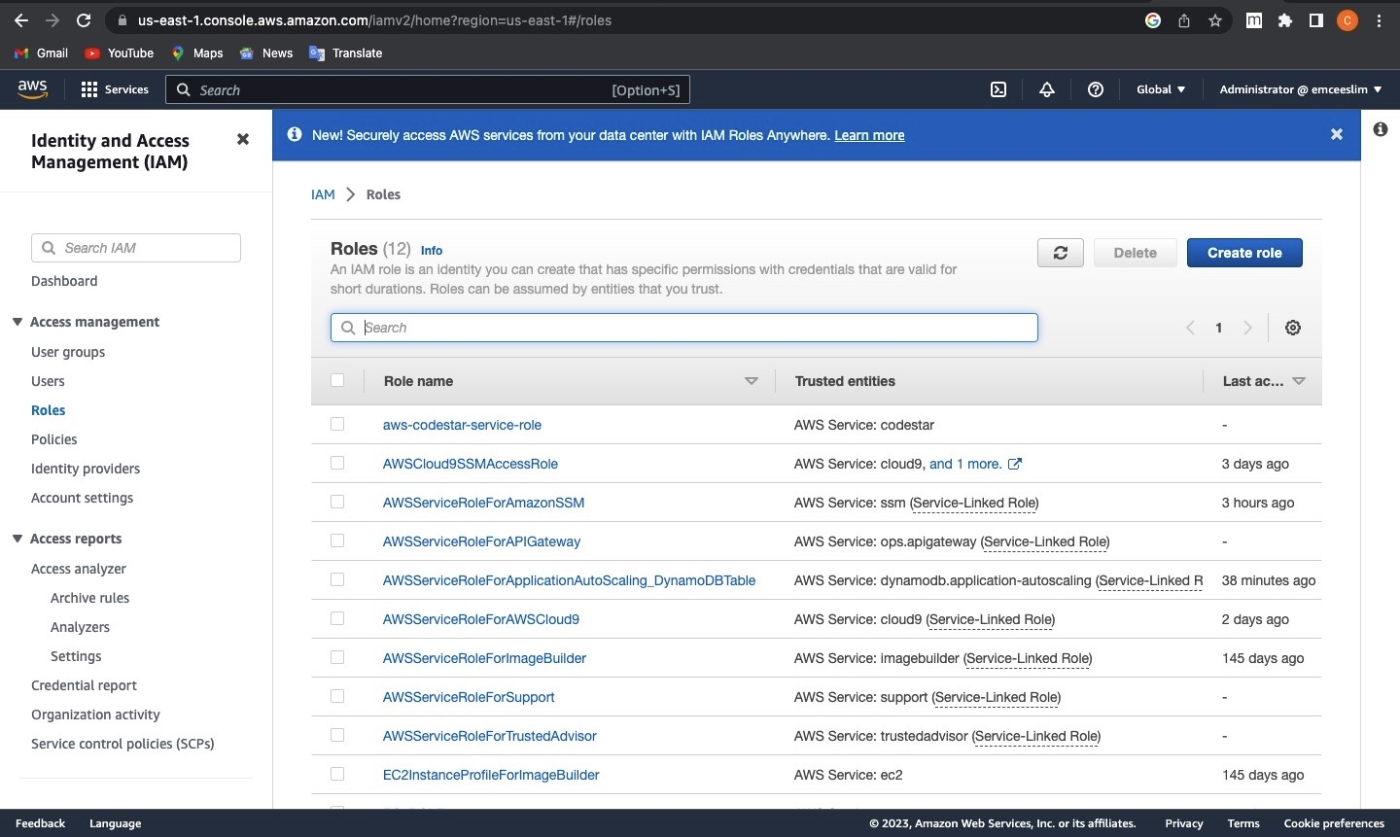
Create Lambda IAM Role

Slide 5
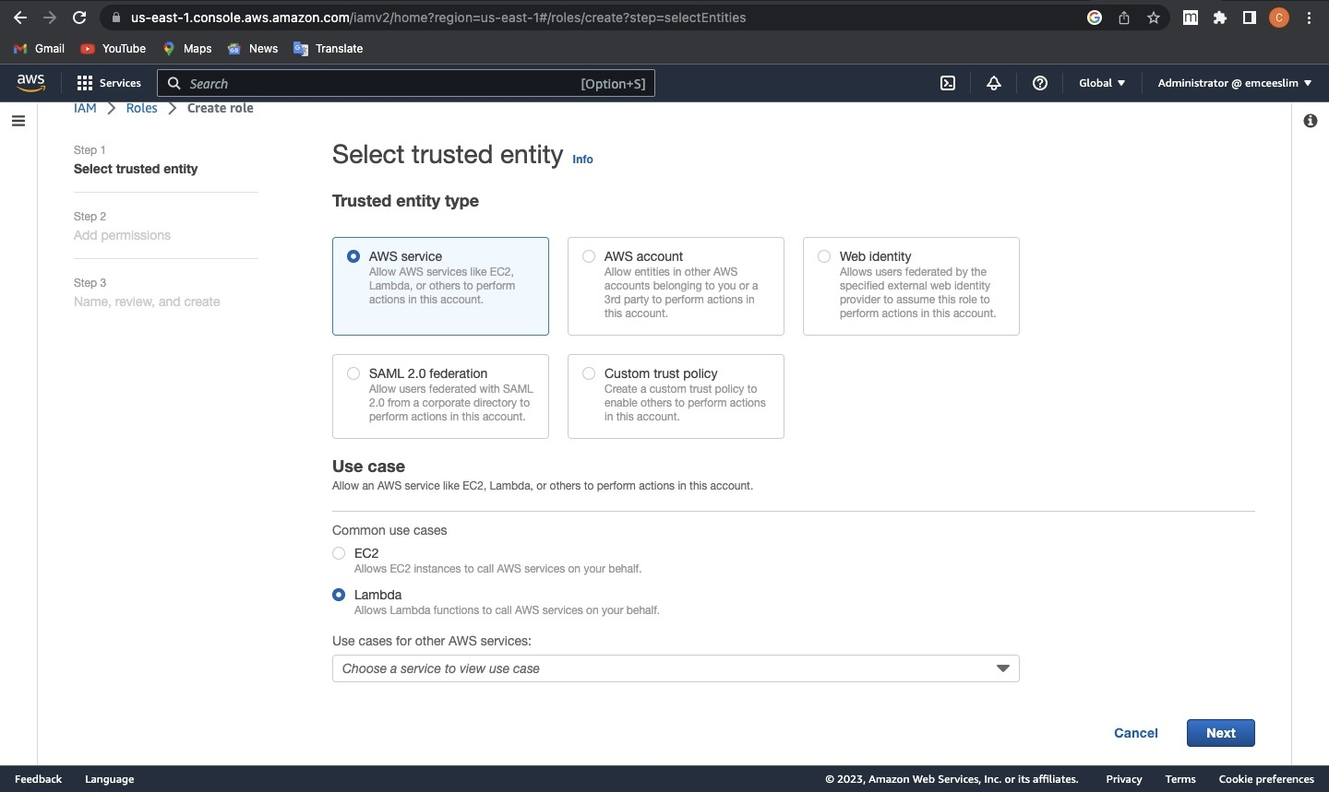
CREATE ROLE

Slide 6
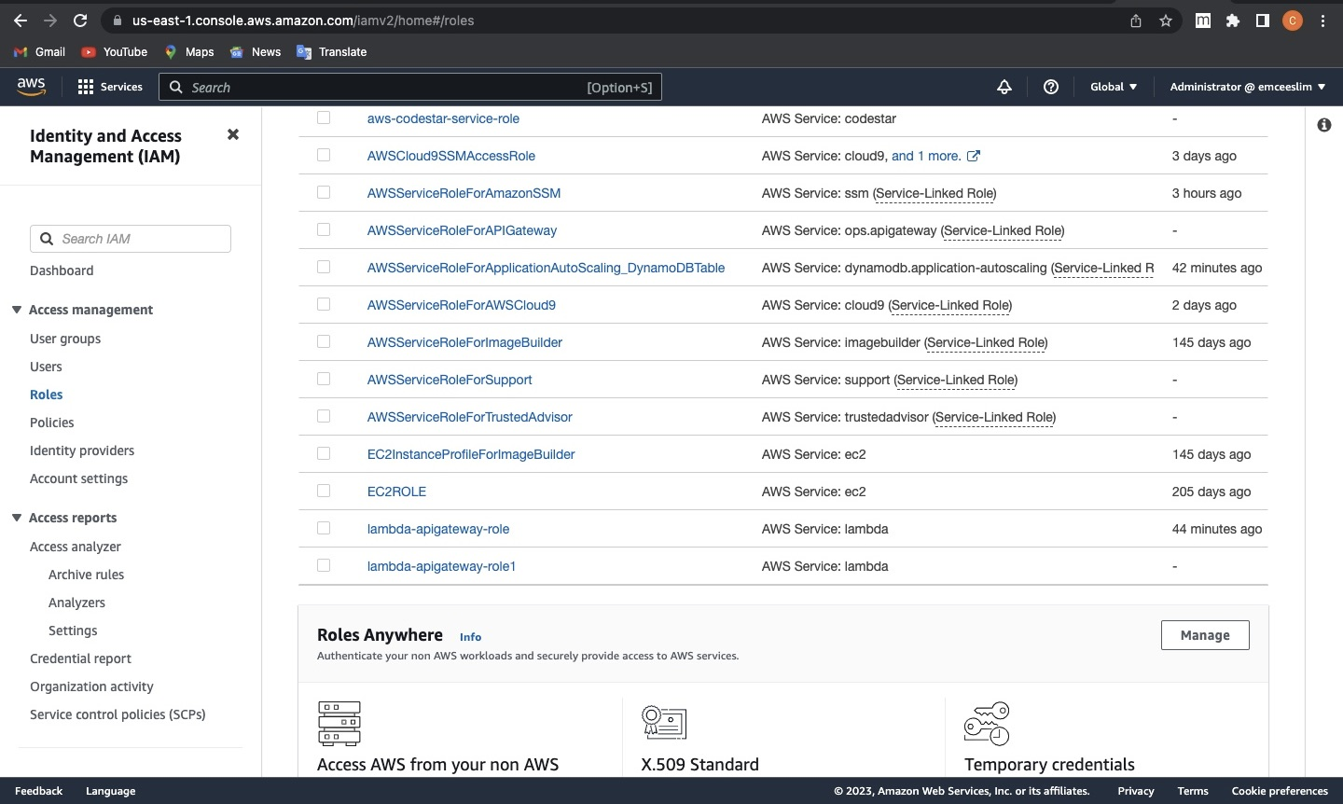
Select Policy

Slide 7
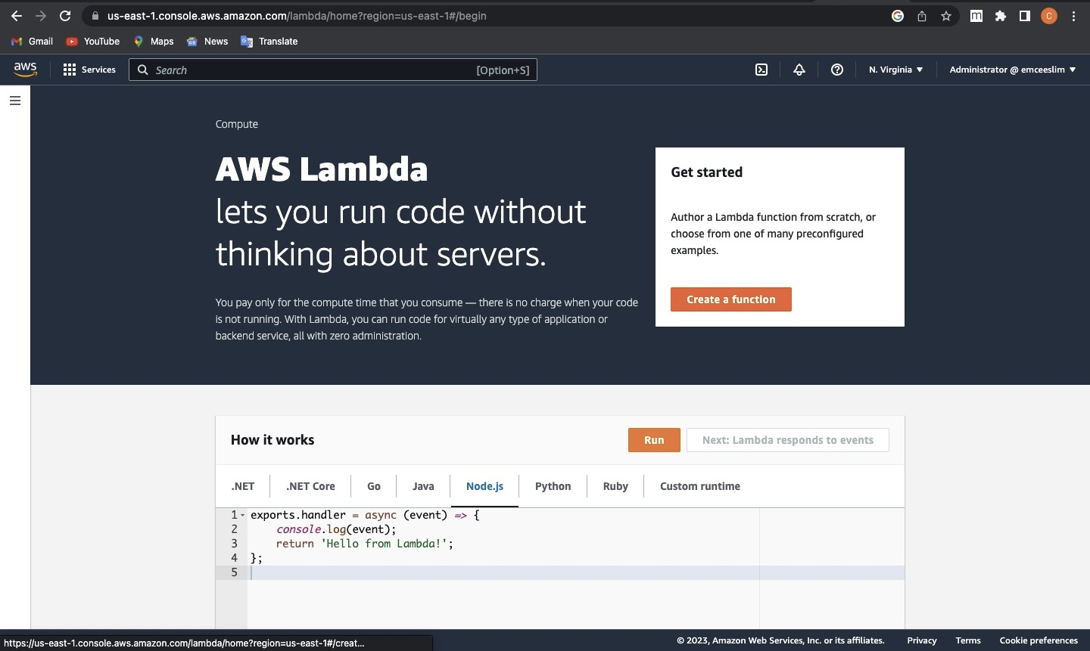
Create Lambda Function

Slide 8
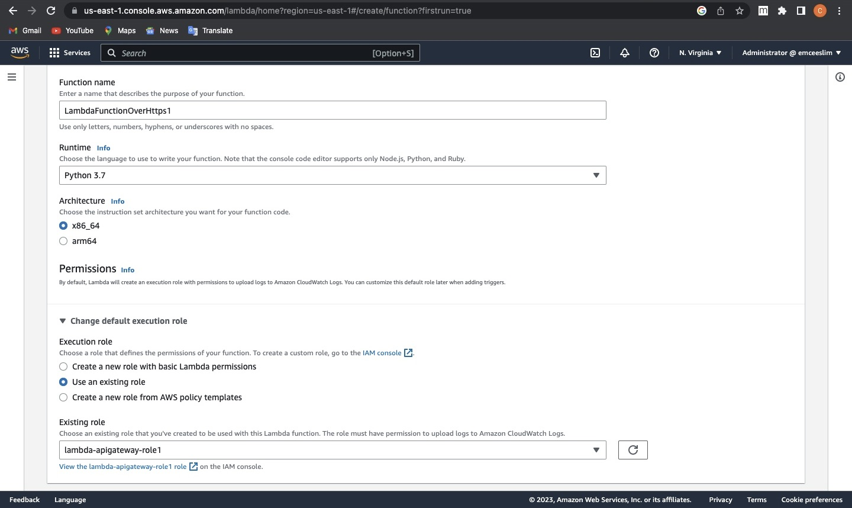
Continuation

Slide 9
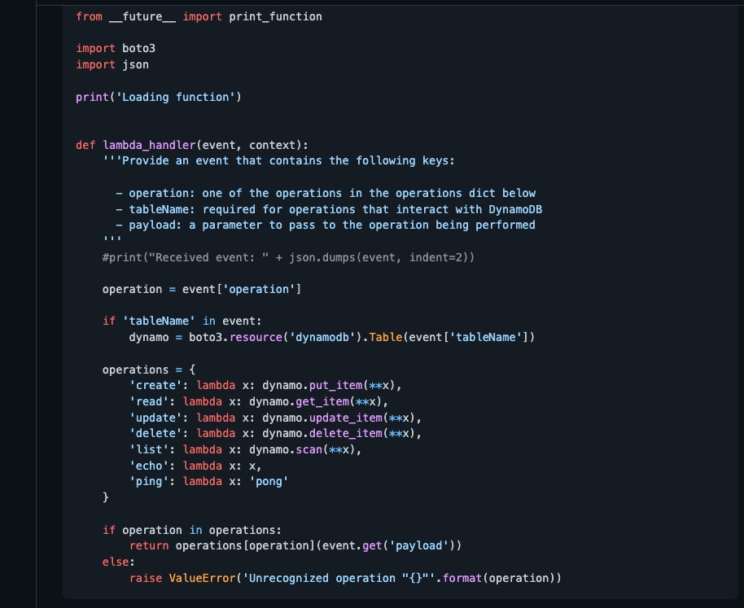
Lambda JSON Code

Slide 10
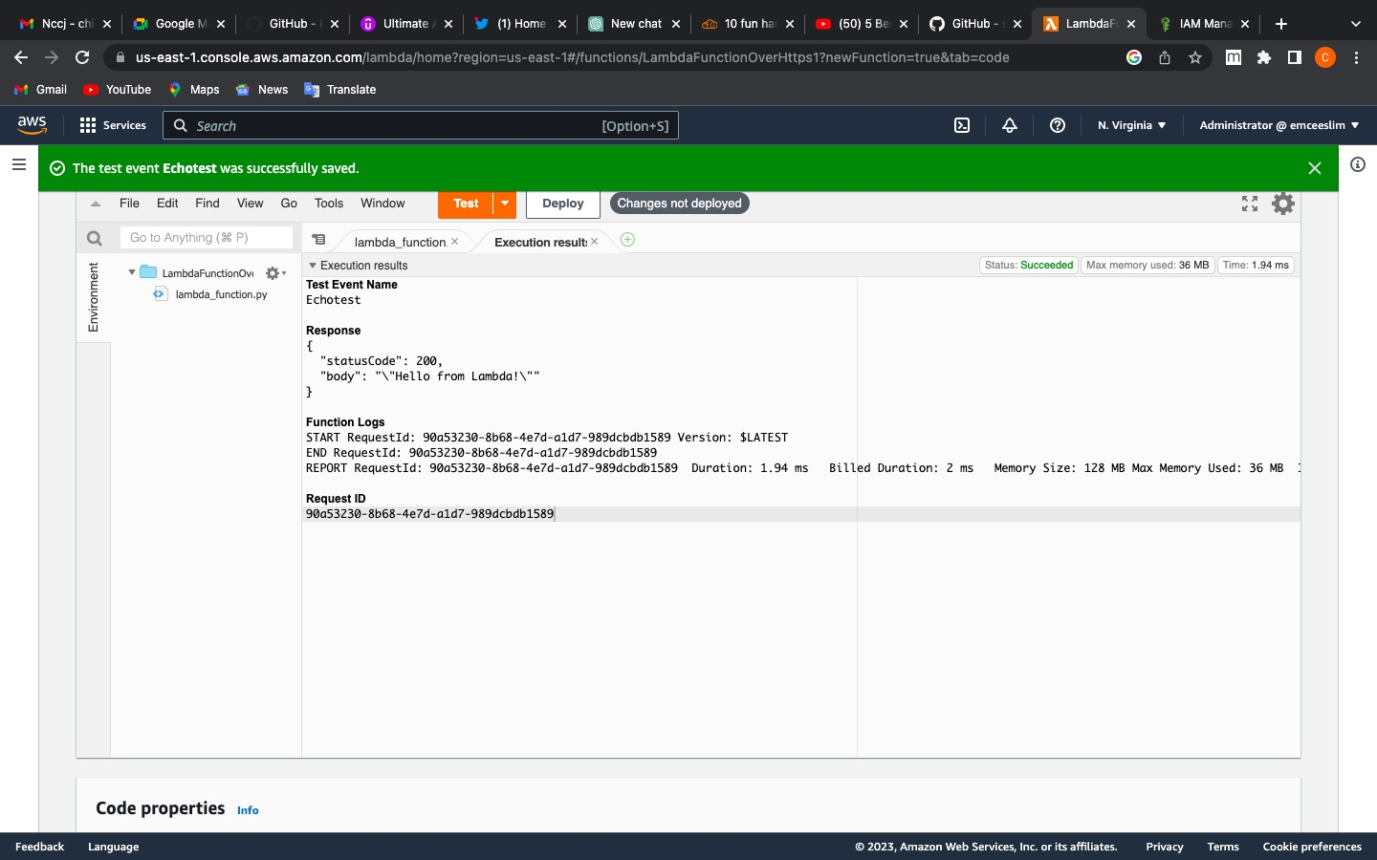
Results for Deployed Code

Slide 11
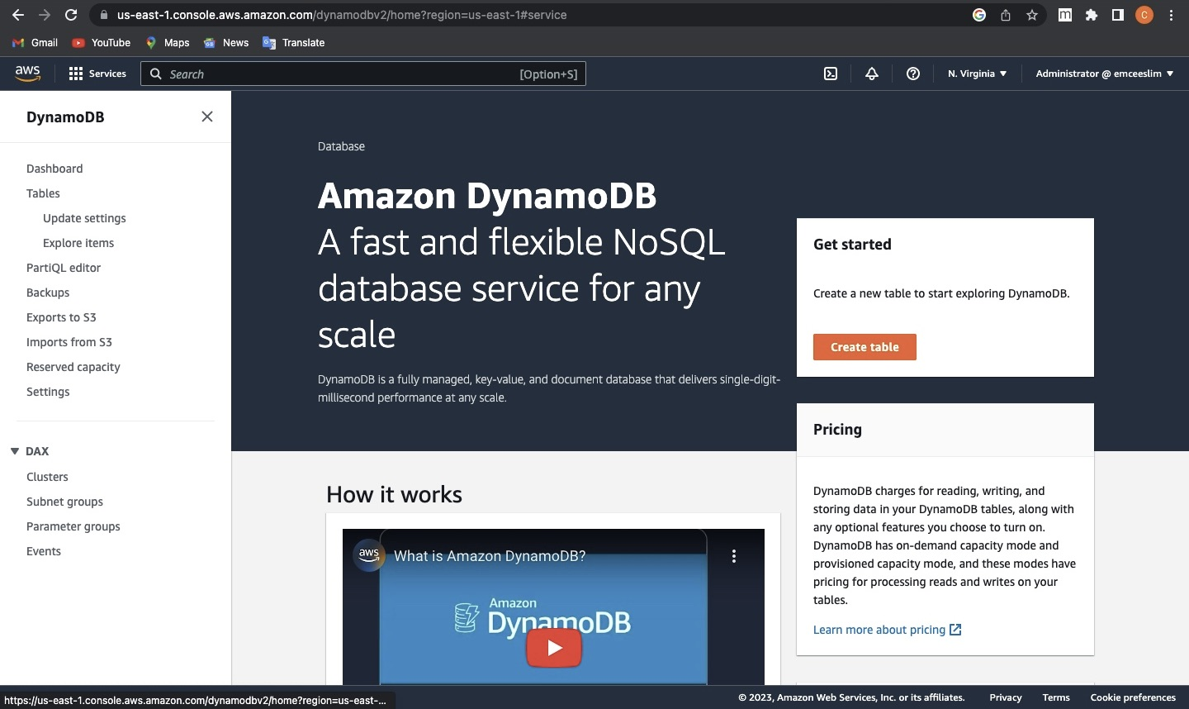
Create DynamoDB Table

Slide 12
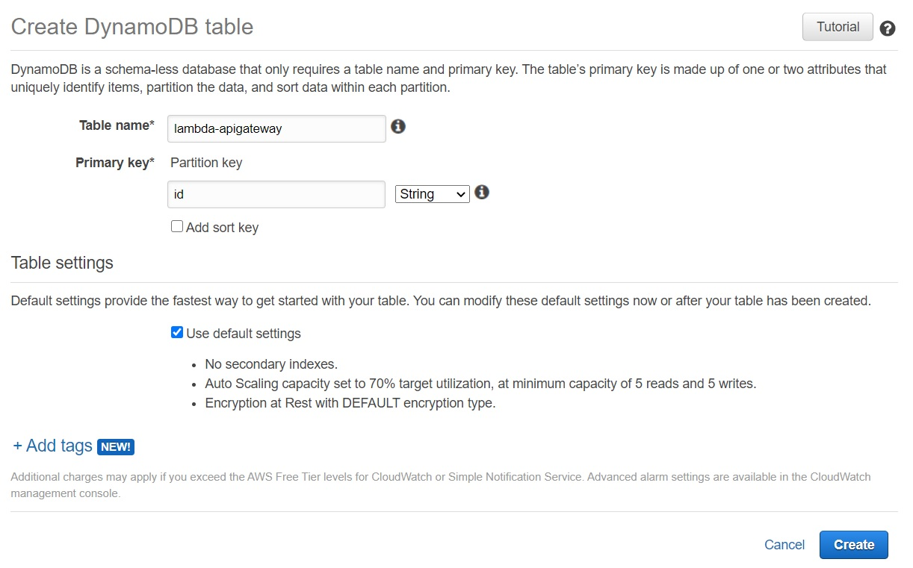
Continuation

Slide 13
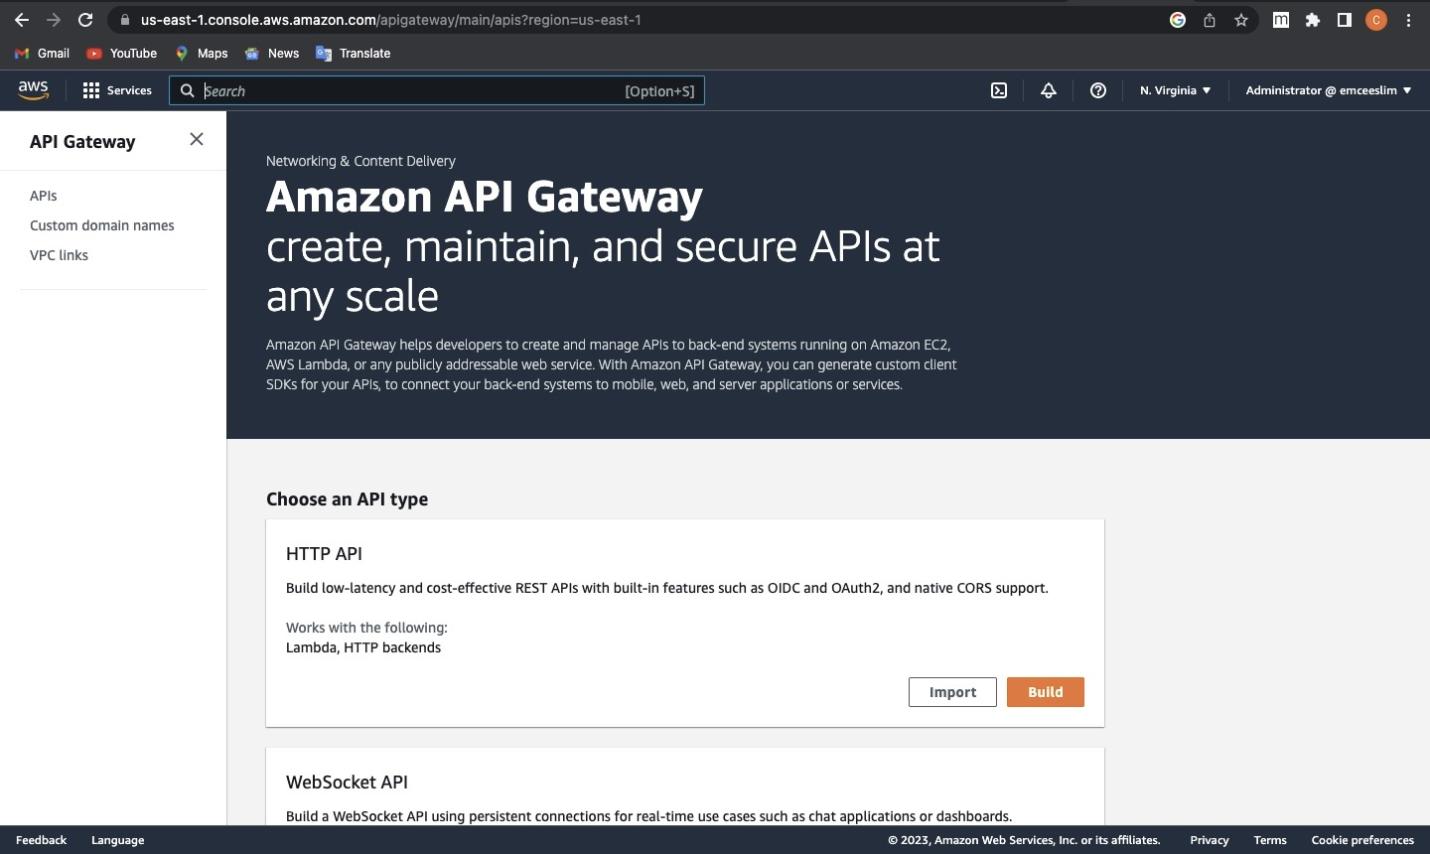
Create API Gateway

Slide 14
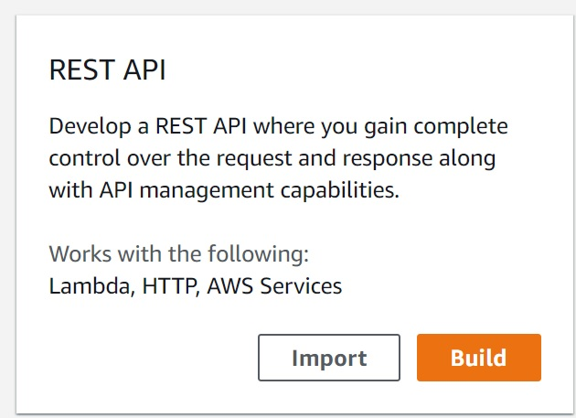
Continuation

Slide 15
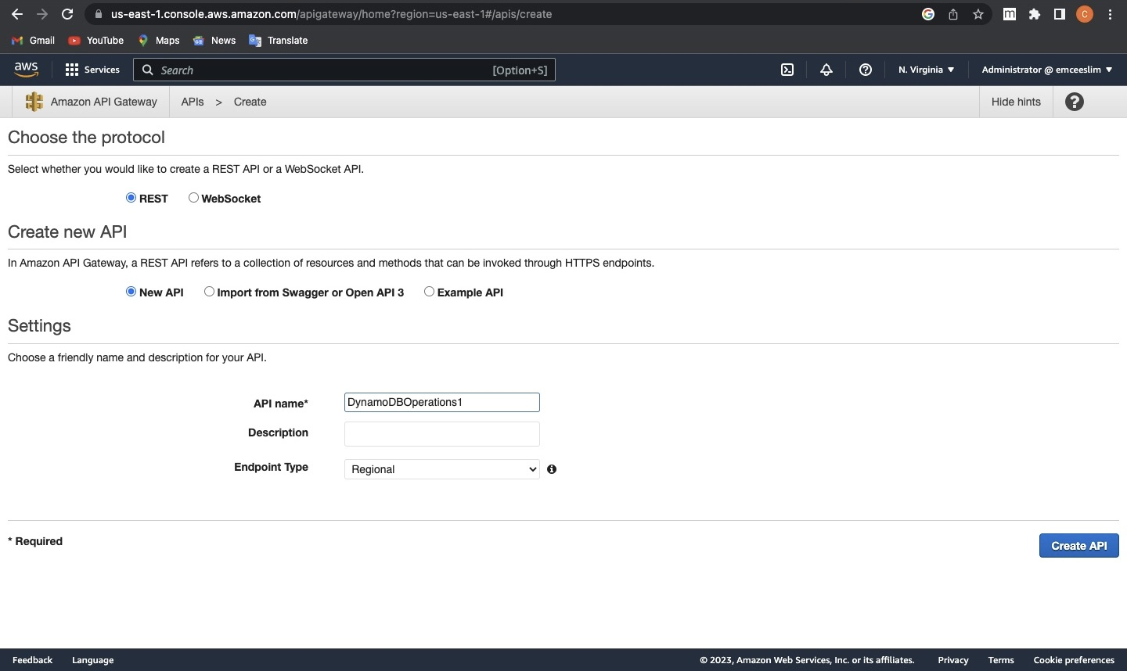
Continuation

Slide 16
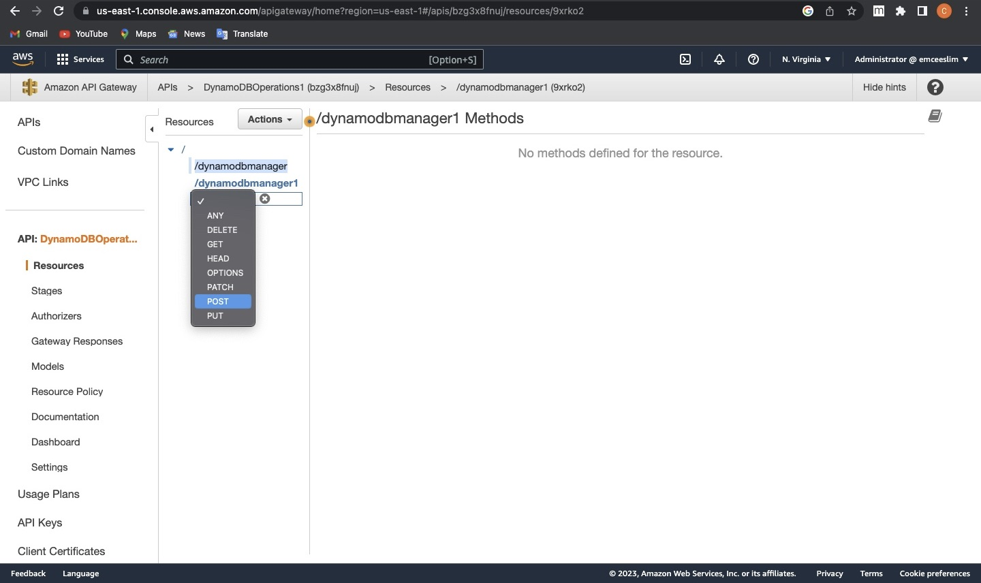
Creation of API Resources

Slide 17
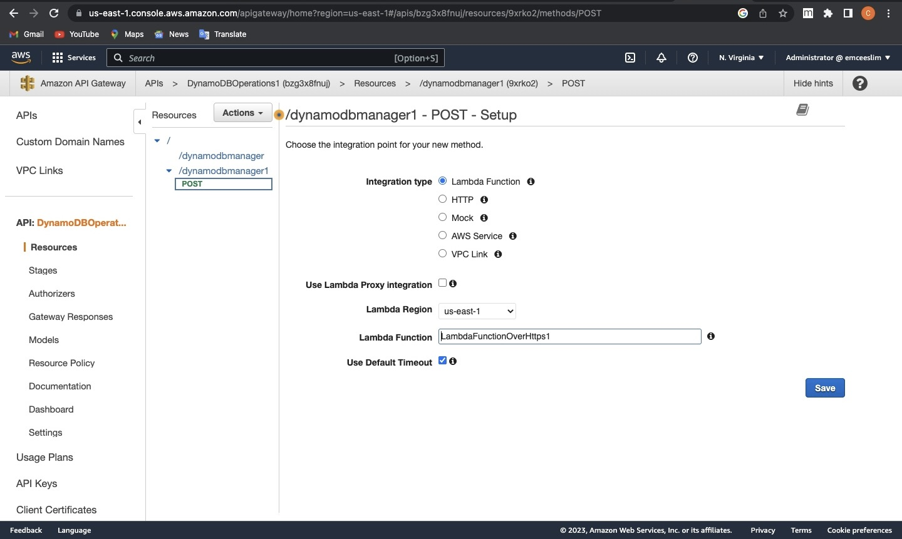
Action Setup

Slide 18
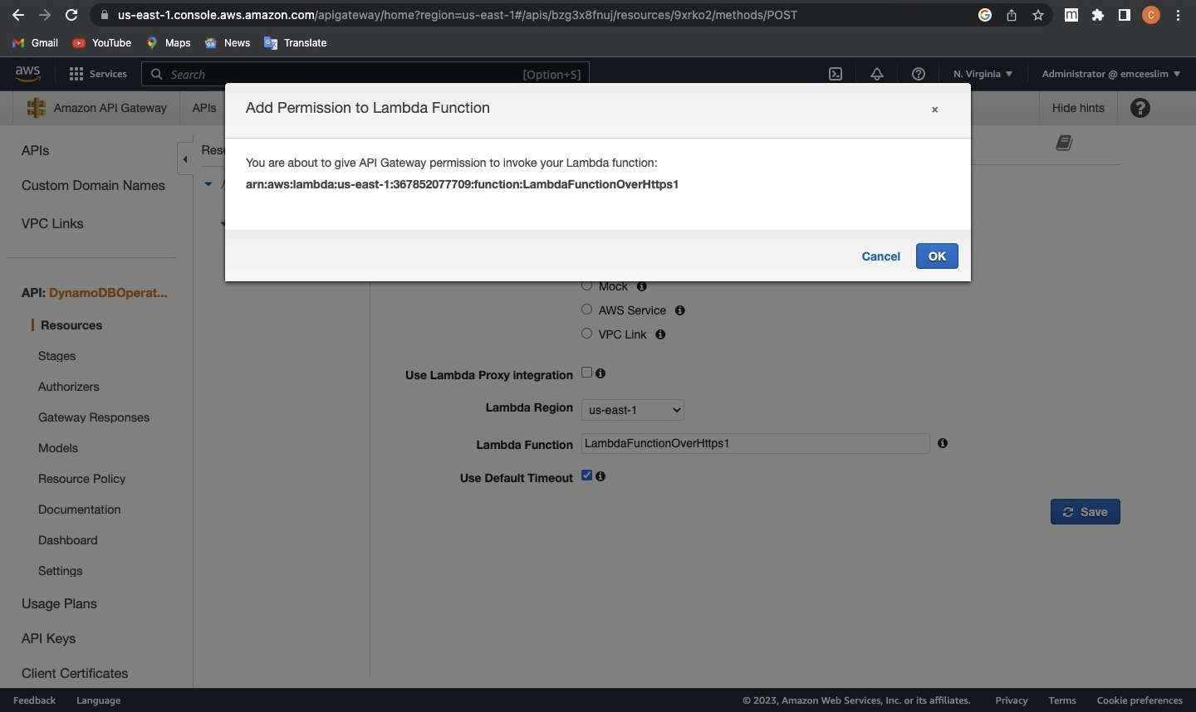
Integration of Lambda Function and API Gateway

Slide 19
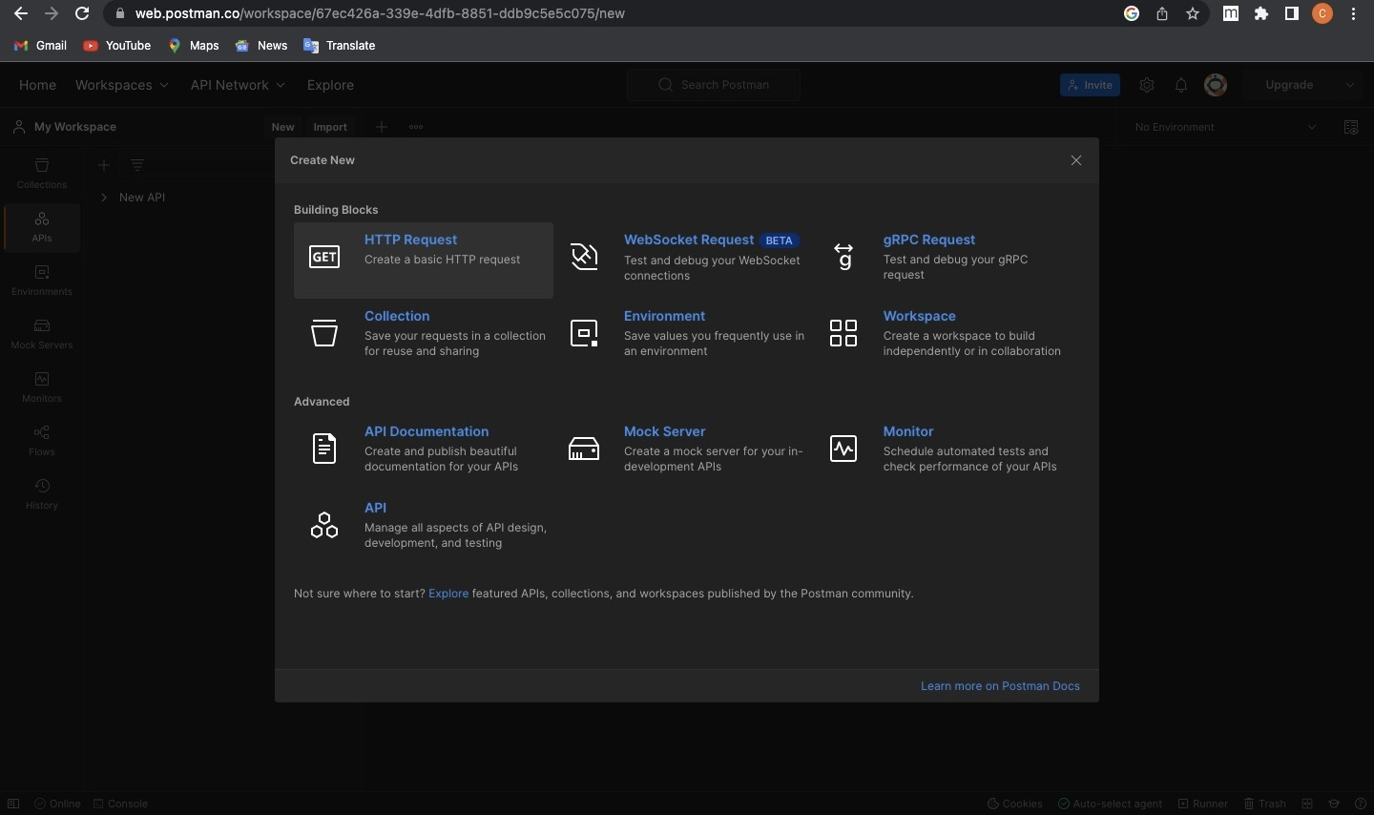
Deployment with Postman

Slide 20
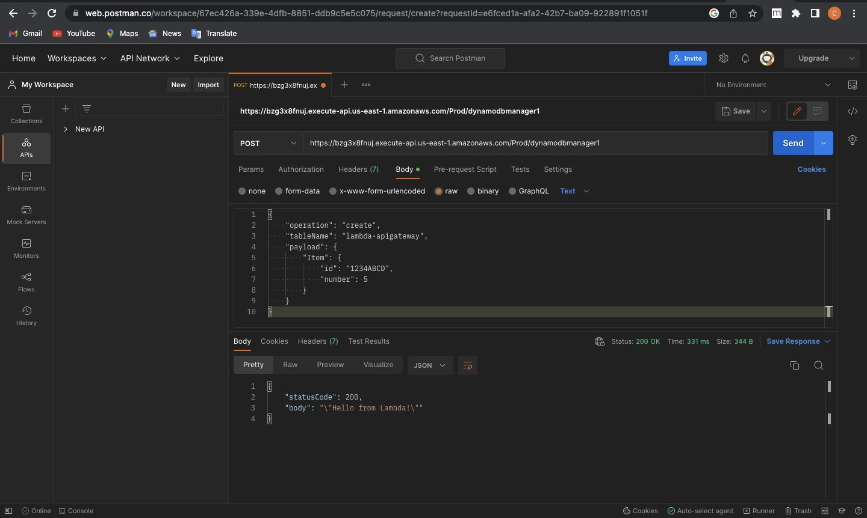
Continuation With Postman

Slide 21
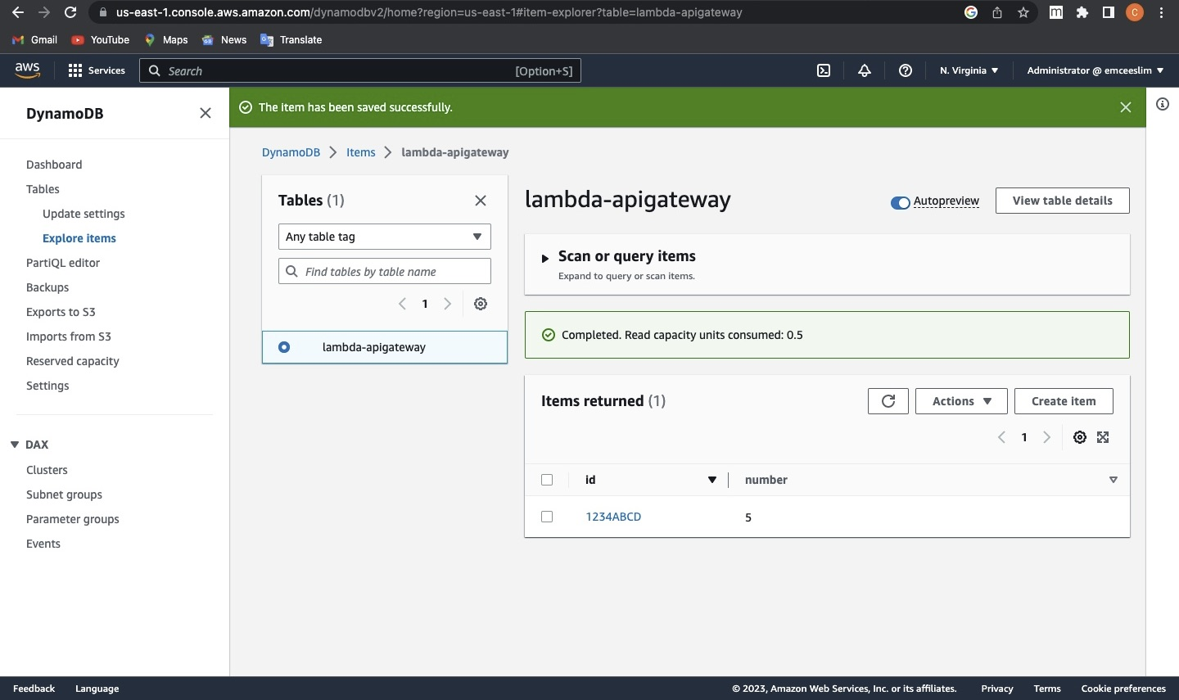
API Updating the DynamoDB Table

